Slide 1
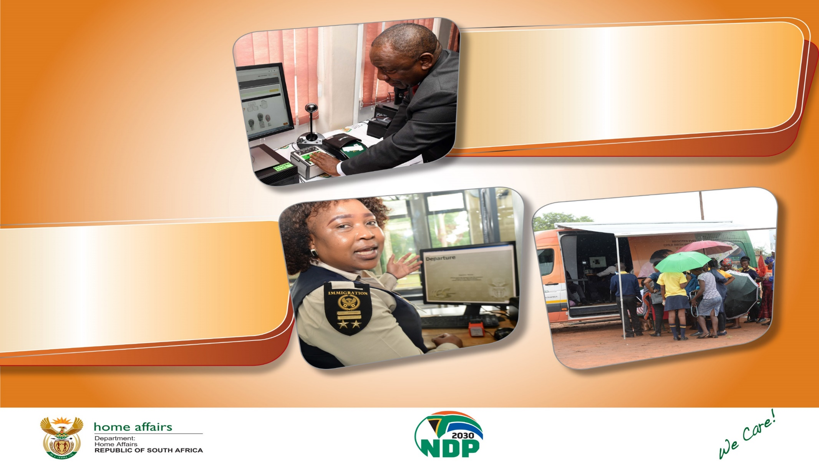
Voter Registration State of Readiness
LOCAL GOVERNMENT ELECTIONS
DATE: 17 SEPTEMBER 2021

Slide 2



Uncollected IDs countrywide

Slide 3
Uncollected Smart ID Cards as at 13 September 2021

Slide 4
Uncollected Smart Id Cards: Eastern Cape as at 13 September 2021
DISTRICT | RE-ISSUE | FIRST ISSUE | TOTAL
JOE GQABI DISTRICT | 1246 | 690 | 1936
BUFFALO CITY METRO | 5093 | 2308 | 7401
ALFRED NZO DISTRICT | 1831 | 1459 | 3290
AMATHOLE DISTRICT | 2880 | 1611 | 4491
NELSON MANDELA BAY METRO | 11325 | 3789 | 15114
CHRIS HANI DISTRICT | 2783 | 1250 | 4033
SARAH BAARTMAN DISTRICT | 2829 | 1172 | 4001
OR TAMBO DISTRICT | 5311 | 3119 | 8430
NELSON MANDELA BAY METRO BANKS | 6 | 42 | 48
BUFFALO CITY METRO MOBILE | 1267 | 1740 | 3007
TOTAL | 34571 | 17180 | 51 751

Slide 5
UNCOLLECTED ID FREE STATE
Uncollected Smart Id Cards: Free State as at 13 September 2021
DISTRICT | RE-ISSUE | FIRST ISSUE | TOTAL
THABOMOFUTSANYANA | 2447 | 1760 | 4207
MANGAUNG METRO | 4460 | 2734 | 7194
LEJWELEPUTSWA | 3150 | 2072 | 5222
XHARIEP | 2061 | 878 | 2939
FEZILE-DABI | 2927 | 1921 | 4848
MANGAUNG METRO MOBILE | 339 | 502 | 841
TOTAL | 15384 | 9867 | 25 251

Slide 6
UNCOLLECTED ID GAUTENG
Uncollected Smart Id Cards: Gauteng as at 13 September 2021
DISTRICT | RE-ISSUE | FIRST ISSUE | TOTAL
TSHWANE | 23636 | 7126 | 30 762
EKURHULENI METRO | 13355 | 5010 | 18365
JOHANNESBURG METRO | 20269 | 5335 | 25604
ECHANNEL | 13395 | 3291 | 16686
SEIDIBENG | 4353 | 2276 | 6629
WESTRAND | 2706 | 1095 | 3801
TSHWANE BANKS | 236 | 78 | 314
JOHANNESBURG METRO BANKS | 365 | 137 | 502
WEST RAND BANKS | 5 | 16 | 21
JOHANNESBURG METRO MOBILE | 178 | 377 | 555
TOTAL | 78498 | 24741 | 103 239

Slide 7
UNCOLLECTED ID KWA ZULU NATAL
Uncollected Smart Id Cards: Kwa Zulu Natal as at 13 September 2021
DISTRICT | RE-ISSUE | FIRST ISSUE | TOTAL
AMAJUBA | 3594 | 2136 | 5730
ETHEKWINI | 16862 | 5457 | 22 319
ZULULAND | 4206 | 3205 | 7411
KING CETSWAYO | 4906 | 2654 | 7560
UMGUNGUNDLOVU | 5052 | 2755 | 7807
ETHEKWINI BANKS | 2 | 5 | 7
ETHEKWINI MOBILE | 107 | 836 | 943
TOTAL | 34729 | 17048 | 51 777

Slide 8
UNCOLLECTED ID LIMPOPO
Uncollected Smart Id Cards: Limpopo as at 13 September 2021
DISTRICT | RE-ISSUE | FIRST ISSUE | TOTAL
CAPRICORN | 3385 | 1956 | 5341
VHEMBE | 3836 | 2466 | 6302
MOPANI | 4416 | 1895 | 6311
SEKHUKHUNE | 2844 | 1397 | 4241
WATERBERG | 2631 | 1447 | 4078
SEKHUKHUNE BANKS | 32 | 293 | 325
CAPRICORN MOBILE | 560 | 2315 | 2875
TOTAL | 17704 | 11769 | 29 473

Slide 9
Uncollected Smart Id Cards: Mpumalanga as at13 September 2021
DISTRICT | RE-ISSUE | FIRST ISSUE | TOTAL
EHLANZENI | 6105 | 3207 | 9312
NKANGALA | 2704 | 876 | 3580
GERT SIBANDE | 4078 | 2073 | 6151
EHLANZENI BANK | 1 | 10 | 11
EHLANZENI MOBILE | 277 | 1737 | 2014
TOTAL | 13165 | 7903 | 21 068

Slide 10
Uncollected Smart Id Cards: North West as at 13 September 2021
DISTRICT | RE-ISSUE | FIRST ISSUE | TOTAL
NMM DISTRICT | 3536 | 1880 | 5416
BOJANALA DISTRICT | 4916 | 1810 | 6726
DR RSM DISTRICT | 1204 | 816 | 2020
DR KK DISTRICT | 3857 | 1568 | 5425
NMM DISTRICT MOBILE | 452 | 1291 | 1743
TOTAL | 13965 | 7365 | 21 330

Slide 11
Uncollected ID cards Northern Cape as at 13 September 2021
DISTRICT | RE-ISSUE | FIRST ISSUE | TOTAL
FRANCES BAARD | 2024 | 1510 | 3534
NAMAKWA | 706 | 251 | 957
PIXLEY KA SEME | 1293 | 772 | 2065
JOHN TAOLO GAETSEWE | 1023 | 567 | 1590
ZF MGCAWU | 2575 | 817 | 3392
FRANCES BAARD MOBILE | 246 | 777 | 1023
TOTAL | 7867 | 4694 | 12561

Slide 12
Uncollected Smart Id Cards: Western Cape as at 13 September 2021
DISTRICT | RE-ISSUE | FIRST ISSUE | TOTAL
WEST COAST | 2471 | 832 | 3303
CENTRAL KAROO | 419 | 206 | 625
CAPE METRO | 16584 | 5770 | 22 354
OVERBERG | 1487 | 504 | 1991
CAPE WINELANDS | 7207 | 2361 | 9 568
GARDEN ROUTE | 2890 | 1069 | 3959
CAPE METRO BANKS | 9 | 13 | 22
CAPE METRO MOBILE | 254 | 467 | 721
TOTAL | 31321 | 11222 | 42 543

Slide 13
Staff deployment: we are deploying 3039 employees

Slide 14
Services to be rendered during this weekend
Issuance of Temporary Identity Certificates (TICs).
Collection of Green Barcoded Identity Books and Smart Identity Cards to applicants.
Manual Verification of Temporary Identity Certificates (TIC).
Resolving challenges pertaining to duplicates, amendments, rectifications and dead alive cases with required supporting documents.
We have deployed 200 people in head office to draw records assist in resolving the above cases
Applications for first time applicants

Slide 15
Offices that will be opened this weekend

Slide 16
Gauteng
Total offices to open is 43
29 are modernised – meaning that they can accept Smart ID Card and passport applications
Three legacy – which means they are not able to take modernised services
Only one office has no generator
Five mobile units to be deployed

Slide 17
GP BANKS OPEN FOR VOTERS REGISTRATION WEEKEND
District / Metro | Bank | Suburb | No. of Staff to be Deployed | Total uncollected | Operating Hours
Johannesburg | ABSA | Sandton | 2 | 280 | 9h00-12h00 Saturday only
Johannesburg | Nedbank | Rivonia | 2 | 369 | 8h30-12h00 Saturday only
Johannesburg | Investec | Sandton | 2 | 182 | 8h00-15h00 Saturday and Sunday
Johannesburg | Nedbank | Lakeview | 2 | 171 | 8h00-17h00 Saturday and Sunday
Johannesburg | FNB | The Glen | 1 | 223 | 8h00-17h00 Saturday
Johannesburg | FNB Merchant | Rivonia | 1 | 325 | 8h30-12h00 Saturday only
Johannesburg | Standard Bank | Killarney Mall | 1 | 225 | 8h30-13h00 Saturday only
Tshwane | FNB Life | Centurion | 1 | 338 | 8h00-13h00
Tshwane | Absa life | Centurion | 1 | 456 | 9h00-12h00 Saturday only
Tshwane | Standard bank Life | Centurion | 1 | 307 | 8h30-12h00 Saturday only
Tshwane | Nedbank | Arcadia | 1 | 269 | 8h30-12h00
Tshwane | FNB The Grove | Lynwood | 1 | 375 | 8h30-12h00 Saturday only

Slide 18
KwaZulu-Natal
Total offices to open is 56
29 are modernised – meaning that they can accept Smart ID Card and passport applications
27 legacy – which means they are not able to take modernised services
Only one office has no generator
13 mobile units to be deployed

Slide 19
Western Cape
Total offices to open is 28
27 are modernised – meaning that they can accept Smart ID Card and passport applications
Only one office is a legacy office and has no generator
Eight mobile units to be deployed
Four banks will open only on Saturday – Standard Bank at the Promindade in Mitchells Plain, Nedbank at Green Market Square, FNB in Green Point and Standard Bank in Canel Walk

Slide 20
Eastern Cape
Total offices to open is 54
32 are modernised – meaning that they can accept Smart ID Card and passport applications
22 legacy – which means they are not able to take modernised services
Of these four have generators
12 mobile units to be deployed

Slide 21
Limpopo
Total offices to open is 42
22 are modernised – meaning that they can accept Smart ID Card and passport applications
20 legacy – which means they are not able to take modernised services
One bank - FNB in Burgersfort
12 mobile units to be deployed

Slide 22
Mpumalanga
Total offices to open is 31
20 are modernised – meaning that they can accept Smart ID Card and passport applications
11 legacy – which means they are not able to take modernised services
One bank – Nedbank at Crossing Nelspruit
10 mobile units to be deployed

Slide 23
North West
Total offices to open is 18
17 are modernised – meaning that they can accept Smart ID Card and passport applications
One legacy – which means it is not able to take modernised services
Six mobile units to be deployed

Slide 24
Free State
Total offices to open is 21
13 are modernised – meaning that they can accept Smart ID Card and passport applications
Eight legacy – which means they are not able to take modernised services
Seven mobile units to be deployed

Slide 25
Northern Cape
Total offices to open is 16
15 are modernised – meaning that they can accept Smart ID Card and passport applications
One legacy office – which means it is not able to take modernised services
Nine mobile units to be deployed

Slide 26
Important
All mobile units have built-in generators
They will assist legacy offices with no generators

Slide 27


Ke ya leboga
Ndiyabulela
Ngiyabonga
Thank you
Inkomu
Ndi khou livhuha
Notes:
BULLET 1: Duran - The Indaba Close out Report should be obtained for evidence.
BULLET 2: Duran - Obtain the finalized MOU.
BULLET 3: James - provide the statistics of children born over weekend and public
BULLET 4: LP (40) & NW (1) - Secondment letters from the North West and Limpopo
BULLET 5: KZN & GP - Certificates for the Ladysmith and Legae health facilities
Reasons before amendment to Saturdays only:
A Birth Registration Indaba was conducted to create awareness.
The MOU with the Department of Health was finalized.
Birth registration on Saturdays and Sundays at high volume offices.
Secondment of provincial personnel to health facilities on a permanent basis.
Two new health facilities were connected.

