Slide 1

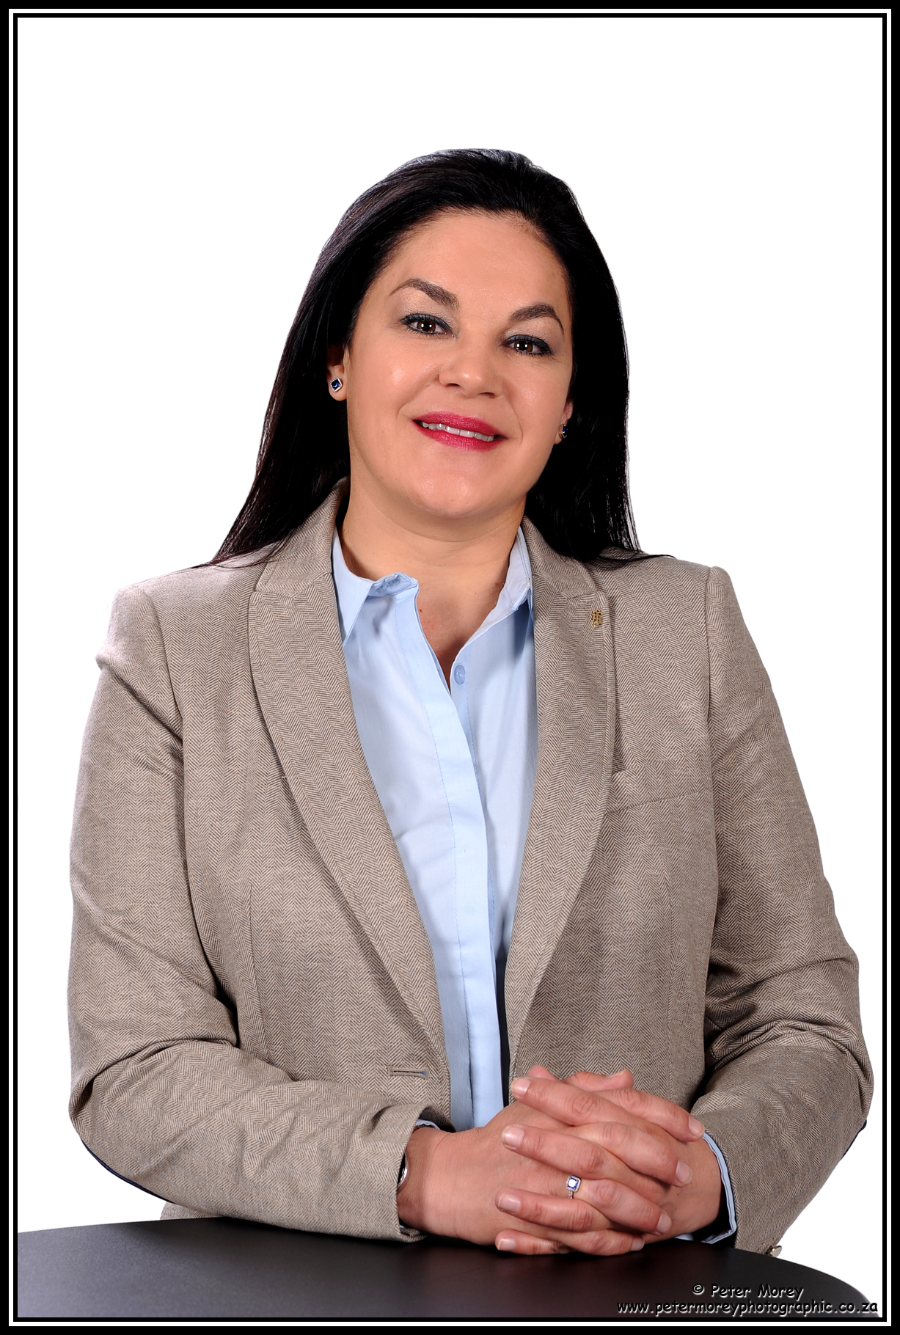



Angelique Montalto
Regional Director, Concur Africa
Angelique was appointed in 2017 to set up the SAP Concur practice in Johannesburg to develop and extend the leading global employee spend management solution into Africa. She has doubled the business year-on-year and her team of passionate Concur-ian’s are meticulous in providing local support with global best practices to African-based customers.
Her experience in international roles across the technology, finance and sales spectrums combined with her love of travel has seen Angelique seizing new opportunities and challenges across the globe including Dublin, London, Barcelona, Berlin and now Johannesburg. She is an active participant in the SAP Business Women’s Network and dedicated to the SAP purpose which is to help the world run better and improve people’s lives.
Angelique is an alumnus of both the University of Cape Town and GIB’s Business School.
Angelique.Montalto@sap.com
@angiem321 Angeliquemontalto

